Slide 1
Chapter 2: Software Design with the
Unified Modeling Language
Session I: UML Fundamentals

Slide 2
Session’s Agenda
UML Fundamentals
  History, goals, etc.
  Classifiers
  Relationships
  Enhancing features
UML Diagrams
  Structural diagrams
  Behavioral diagrams
UML Summary
  What’s next…

Slide 3



Unified Modeling Language Fundamentals
Communication is an essential, critical skill for engineers.
  Throughout a project’s life-cycle, designers spent a great deal of time and effort communicating with other members of the project.
    Oral
    Written
  In previous sessions, we discussed the importance of managing design influences.
    Imagine, if stakeholders used different languages for communication.
  Different languages of communication would decrease efficiency and effectiveness.
我想表現！
Quiero facilidad de uso!
I want Security!
A wants …
B wants …
3

Slide 4
Unified Modeling Language Fundamentals
The UML is the result of years of collaborative work spent in devising a unified approach for modeling systems.
  The first efforts focused on unifying three popular modeling methods:
    The Booch method, by Grady Booch
    The object-oriented software engineering method (OOSE), by Ivar Jacobson
    The object modeling technique (OMT) by James Rumbaugh
The goals of the unification project were specified by Booch, Rumbaugh, and Jacobson as follows:
  To model systems, from concept to executable artifact, using object-oriented techniques.
  To address the issues of scale inherent in complex, mission-critical systems.
  To create a modeling language usable by both humans and machines.
The development of early UML versions generated interest among numerous influential organizations.
  Microsoft, Oracle, IBM, Rational, etc. This collaborative effort resulted in UML 1.0.
  After revisions, it was accepted by the OMG as UML 1.1.
  Since then, UML has evolved and accepted heavily in industry.

Slide 5
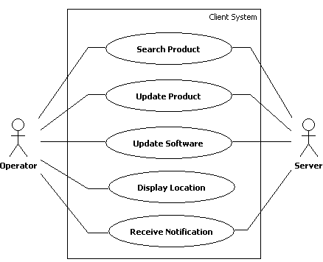
Unified Modeling Language Fundamentals
Formally, UML can be defined as a visual language for specifying, analyzing, and documenting design elements essential for modeling the dynamic and static aspects of software systems before construction.
UML 2.3 provides 14 types of diagrams that can be used for modeling both
  Structural
  Behavioral
Because projects vary drastically, not all diagrams are used in every project.
  Designers select the ones that can help them effectively model the system.
我想表現！
Quiero facilidad de uso!
I want Security!
I see… We all agree…

Slide 6
Unified Modeling Language Fundamentals
Officially, UML Structural Diagrams
  Concerned with capturing and specifying static elements and their interrelationships required for supporting the solution to a given problem, within a given context.
Behavioral Diagrams
  Concerned with capturing and specifying the dynamic behavior and the inherent complexities present in the behavioral aspects of software systems.

Slide 7
Unified Modeling Language Fundamentals
To model almost any aspect of today’s modern system, UML was developed with flexibility and extensibility in mind.
  However, the fundamental building blocks are well defined and must be understood before applying UML effectively.
UML’s building blocks are grouped into:
  Classifiers
    Structural things that represent conceptual or physical elements of a model.
    They are typically the main elements in UML diagrams.
    Each type of UML diagram, uses specific type of classifiers, so that not all classifiers are relevant to all UML diagrams.
  Relationships
    Defines and provides visualization of the interconnections that exists among classifiers.
  Enhancing features
    Provides flexibility that allow designers to enhance and evolve modeling capabilities so that they become appropriate for particular systems.
Let’s cover the building blocks in more detail…

Slide 8
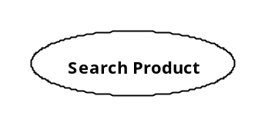
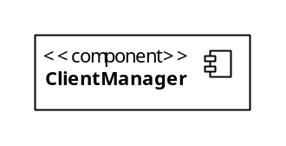
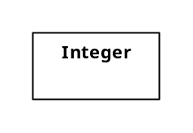
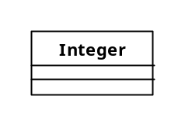
UML 2.3 Classifiers
UML 2.3 classifiers include:
  Use Case
    Classifier used to model a single required system behavior; represented with icons of elliptical shape.
  Component
    Classifier used to represent a modular and replaceable part of the system; modeled using a box with the keyword <<component>> and optional component icon on the top right corner.
  Class
    Classifier used to model a type in terms of operations, attributes, relationships, and other semantics; modeled using a rectangular box. Typically, a class is split into compartments for attributes and operations.

Slide 9
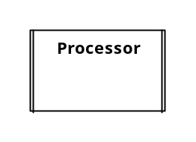
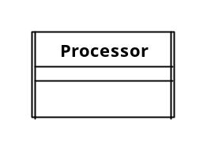
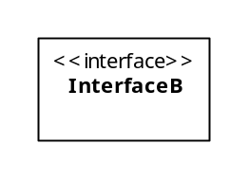
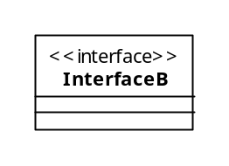
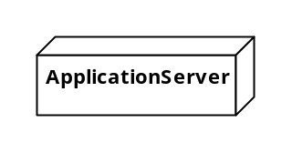
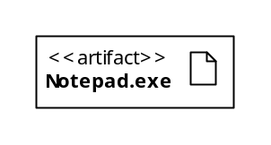
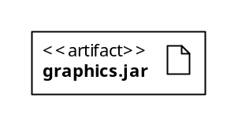
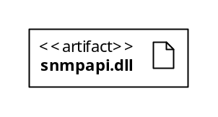
UML 2.3 Classifiers
UML 2.3 common classifiers include (continued):
  Active Class
    Classifier used to model a class that owns an independent flow of execution and can initiate control activity; modeled as a class with double lines on each side.
  Interface
    Classifier that models the set of operations that specify the services provided by a class or component; represented as stereotyped classes or using the ball-and-socket notation.
  Node
    Classifier used to model a physical element (e.g., a computer), its processing capabilities, and other characteristics; modeled using a cube.
  Artifact
    Classifier that models a physical deployable information element (e.g., .dll, .exe, .jar, .script, etc.); modeled using a rectangle with the keyword <<artifact>>,
InterfaceB

Slide 10
UML 2.3 Relationships
Relationships apply to all UML Classifiers. UML relationships include:
  Dependency
    Dashed line (typically directed with a stick arrow) used to model the relationship between two UML classifiers indicating that changes to one element affect the other.
  Association
    Line used to model the relationship between two UML classifiers indicating that a connection exists between them; associations can be directed using a stick arrow.
  Generalization
    Line with a hollow arrowhead used to model the relationship between two UML classifiers indicating that one (child) inherits from another (parent).
  Realization
    Relationship between two UML classifiers indicating that one element realizes a specified interface; modeled using a dashed line with hollow arrowhead.

Slide 11
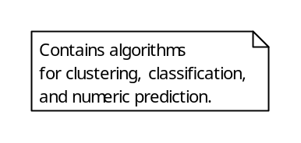
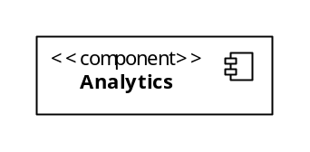
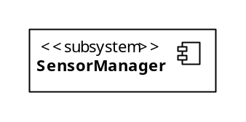
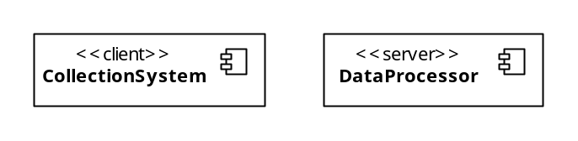
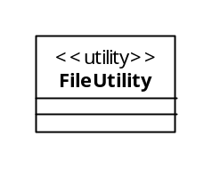
UML 2.3 Enhancing Features
Common UML mechanisms for enhancement:
  Notes
    Mechanism for adding descriptive information to UML elements (both classifiers and relationships) and diagrams; modeled using a rectangle with a dog-eared corner and can be connected using a dashed line.
  Stereotypes
    Mechanism for extending UML by adding information that gives existing UML elements (both classifiers and relationships) a different meaning, therefore creating a semantically different element for modeling application-specific concepts; modeled as existing UML elements with the <<stereotype>> mechanism.
UML Note
Stereotyped Components
Stereotyped Class

Slide 12
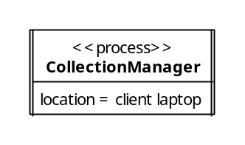
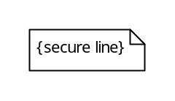
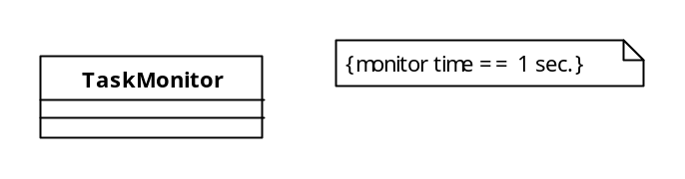
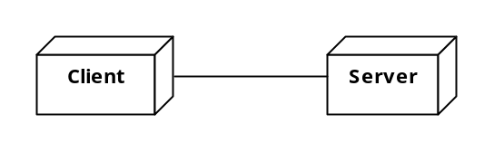
UML 2.3 Enhancing Features
Common UML mechanisms for enhancement (continued):
  Tagged values
    Mechanism for adding new properties to a stereotype; modeled by adding the tagged value in the form of property = value to existing stereotyped UML elements.
  Constraints
    Mechanism for specifying constraints to design elements (both classifiers and relationships); associated with specific design elements in the form of {constraint description}
Tagged value to specify location
Constraint
Constraint

Slide 13
UML 2.3 Diagrams - Structural
Together, UML classifiers, relationships, and enhancement features can be used together in 14 diagrams to model systems from different perspectives and different concerns.
The most common UML structural diagrams are presented below.
Other structural diagrams include:
  Composite structure diagram
  Profile diagram
Structural Diagram | Description
Component Diagram | Used to model software as group of components connected to each other through well-defined interfaces.
Class Diagram | Used to model software as a set of classes, including their operations, attributes, and relationships.
Object Diagram | Used to model an instant snapshot of the life of an object during execution, including its state and attribute values.
Deployment Diagram | Used to model the physical realization of software systems, including physical nodes where software is deployed, interfaces between nodes, executable software artifacts, and the manifestation of software components.
Package Diagram | Used to model the decomposition of software as a set of packages, including relationships between packages.

Slide 14
UML 2.3 Diagrams - Behavioral
The most common UML behavioral diagrams are presented below.
Other behavioral diagrams include:
  Timing diagram
  Interaction overview diagram
Behavioral Diagram | Description
Use Case Diagram | Used to capture, specify, and visualize required system behavior .
Sequence Diagram | Used to capture, specify, and visualize system interactions with emphasis on the time-order sequence of messages exchanged.
Communication Diagram | Used to capture, specify, and visualize system interactions with emphasis on the structural order of entities participating in the message exchange.
State Machine Diagram | Used to capture, specify, and visualize system behavior as a set of discrete states and the transitions between them.
Activity Diagram | Used to capture, specify, and visualize system behavior; provide mechanisms for modeling that includes conditional statements, repetition, concurrency, and parallel execution and thus can be used at many different levels of abstraction, from modeling business work flows to code.

Slide 15
UML Summary
UML is essential to enhancing system analysis, specification, and communication among a project’s stakeholders. Specifically, UML
  Provides a common language for analyzing, evaluating, and specifying systems.
  Models can be created at higher levels and transferred downstream, for subsequent, finer-grained analysis, evaluation, and specification.
  Models serve as the main tool for transferring knowledge and enhancing communication among stakeholders, including customers, managers, and programmers.
  Enables visualization of complex systems and enables more efficient reasoning about the problem, therefore enhancing the problem-solving process.
  Enhances design documents and enables reusability of solutions, which can be applied in future projects.

Slide 16
What’s Next…
In the next session we will discuss how UML classifiers, relationships, and enhancement features can be used to create structural diagrams. Specifically, we will focus on:
  UML structural modeling
    What is structural modeling?
    Why is it important?
  Component diagrams
    Interfaces
    Assembly connectors
    Other common relationships
  Class diagrams
    Details of UML classes
    Common relationships
    The meaning (in code) of class diagrams
  Deployment diagrams

